Slide 1
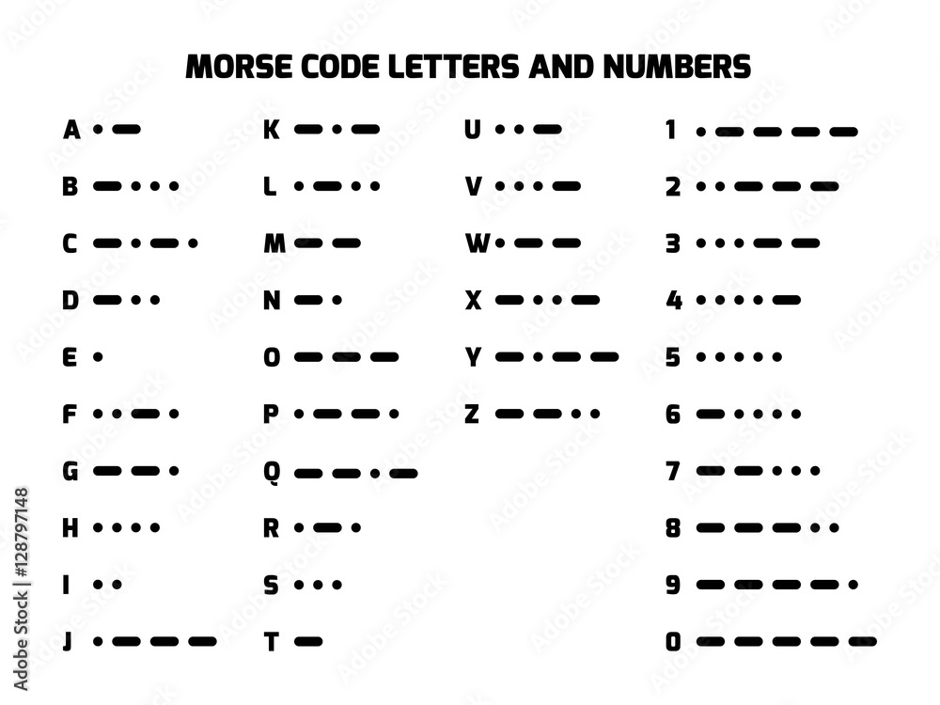
A (example) (FYI)
Starting

Slide 2
A

Slide 3
B

Slide 4
C

Slide 5
D

Slide 6
E

Slide 7
F

Slide 8
G

Slide 9
H

Slide 10
I

Slide 11
J

Slide 12
K

Slide 13
L

Slide 14
M

Slide 15
N

Slide 16
O

Slide 17
P

Slide 18
Q

Slide 19
R

Slide 20
S

Slide 21
T

Slide 22
U

Slide 23
V

Slide 24
W

Slide 25
X

Slide 26
Y

Slide 27
Z

Slide 28
0

Slide 29
1

Slide 30
2

Slide 31
3

Slide 32
4

Slide 33
5

Slide 34
6

Slide 35
7

Slide 36
8

Slide 37
9

